Slide 1
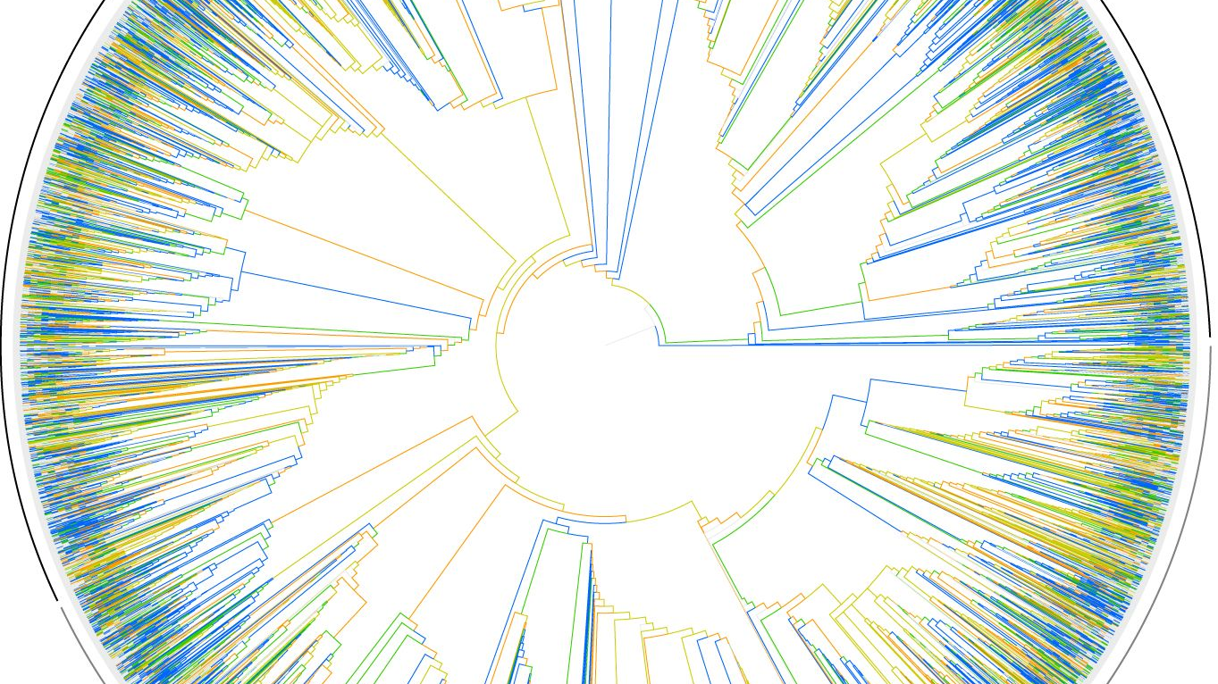
Lab Update: Mosaic Mixta
Kimberly Hinz
Notes:
https://www.pinterest.ca/pin/347340189992893352/?lp=true

Slide 2
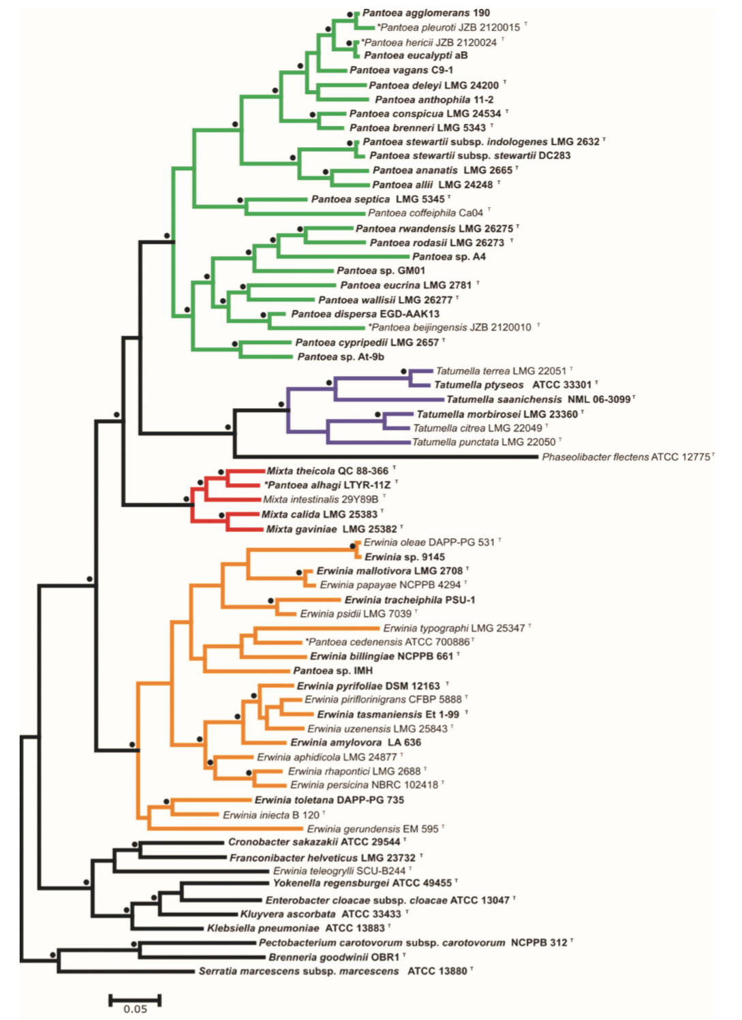
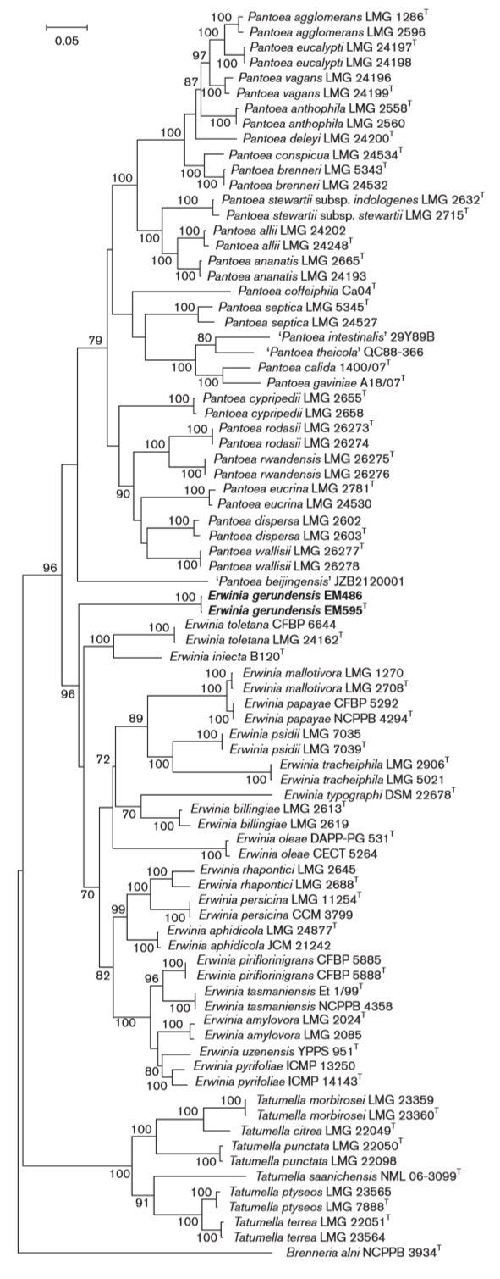
Pantoea
Mixta
Erwinia
Notes:
LEFT: paper released last year by Palmer et al. RIGHT: paper released in 2016 by Rezzonico et al.
Both conducted maximum likelihood trees with ATPD, GYRB, INFB, and RPOB
BUT, Palmer et al. reconstructed protein sequences and Rezzonico et al. used nucleotide sequences.

Slide 3
Mosaic Mixta
10 genomes
Determine homologous genes
Distance matrices for each gene
Categorize each gene origin
Mixta species
Notes:
Can also be used to determine HGT

Slide 4

10 Genomes
Mixta calida
Mixta gaviniae
Pantoea septica
Pantoea agglomerans
Erwinia amylovora
Erwinia tasmaniensis
Tatumella saanichensis
Tatumella ptyseos
Citrobacter freundii
Enterobacter cloacae

Slide 5
Solution: Filter
/
10 sequences
1
Check for 20 rows in the fasta file.
No truncated genes
2
Length of sequences >= 90% of the longest sequence
Also shortened the sequence names
Gene ID and species’ name
3
1284 sequence → 1035 sequences

Slide 6
Alignment and Distance Matrices
 | Mixta calida | Mixta gaviniae
Pantoea | 904 genes 79 P. agglomerans 825 P. septica | 903 genes 71 P. agglomerans 832 P. septica
Erwinia | 102 genes 49 E. amylovora 53 E. tasmaniensis | 108 genes 52 E. amylovora 56 E. tasmaniensis
Tatumella | 5 genes 3 T. ptyseos 2 T. saanichensis | 6 genes 3 T. ptyseos 3 T. saanichensis
Outgroup | 18 genes 8 C. freundii 10 E. cloacae | 18 genes 7 C. freundii 11 E. cloacae
Alignments: R package msa::msaClustalW
100 max. iterations
Default settings
Distance matrices: R package ape and adegenet
Tamura 1992 Model

Slide 7
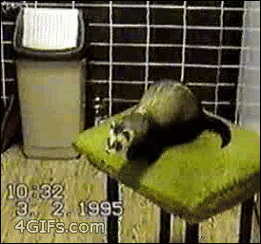
My Data:

Slide 8

NEW METHOD! NEW RESULTS!

Slide 9
Closest Relatives
M. calida
M. gaviniae
Gene | First | Second
38235_csdA | E. tasmaniensis | M. gaviniae
38434_hypo | P. septica | E. cloacae
38746_fhuA_1 | E. amylovora | C. freundii
38985_ttuB | T. ptyseos | T. saanichensis
39549_hypo | E. amylovora | M. gaviniae
Gene | First | Second
38235_csdA | P.agglomerans | P. septica
38434_hypo | P.agglomerans | P. septica
38747_fhuA_1 | E. tasmaniensis | P. septica
38985_ttuB | P. agglomerans | P. septica
39549_hypo | E. amylovora | M. calida
Notes:
5 Weird genes
First and second closest relative (that was not itself)

Slide 10
Closest Relatives
M. calida
M. gaviniae
Gene | First | Second
38235_csdA | E. tasmaniensis | M. gaviniae
38434_hypo | P. septica | E. cloacae
38746_fhuA_1 | E. amylovora | C. freundii
38985_ttuB | T. ptyseos | T. saanichensis
39549_hypo | E. amylovora | M. gaviniae
Gene | First | Second
38235_csdA | P.agglomerans | P. septica
38434_hypo | P.agglomerans | P. septica
38747_fhuA_1 | E. tasmaniensis | P. septica
38985_ttuB | P. agglomerans | P. septica
39549_hypo | E. amylovora | M. calida
Notes:
Highlighted: first and second are from the same genus. Makes sense, maybe horizontal gene transfer to this species.
38985_ttuB is present in both, but came from different genera

Slide 11
Closest Relatives
M. calida
M. gaviniae
Gene | First | Second
38235_csdA | E. tasmaniensis | M. gaviniae
38434_hypo | P. septica | E. cloacae
38746_fhuA_1 | E. amylovora | C. freundii
38985_ttuB | T. ptyseos | T. saanichensis
39549_hypo | E. amylovora | M. gaviniae
Gene | First | Second
38235_csdA | P.agglomerans | P. septica
38434_hypo | P.agglomerans | P. septica
38747_fhuA_1 | E. tasmaniensis | P. septica
38985_ttuB | P. agglomerans | P. septica
39549_hypo | E. amylovora | M. calida
Notes:
First relative is NOT Mixta, but the second is??

Slide 12
Closest Relatives
M. calida
M. gaviniae
Gene | First | Second
38235_csdA | E. tasmaniensis | M. gaviniae
38434_hypo | P. septica | E. cloacae
38746_fhuA_1 | E. amylovora | C. freundii
38985_ttuB | T. ptyseos | T. saanichensis
39549_hypo | E. amylovora | M. gaviniae
Gene | First | Second
38235_csdA | P.agglomerans | P. septica
38434_hypo | P.agglomerans | P. septica
38747_fhuA_1 | E. tasmaniensis | P. septica
38985_ttuB | P. agglomerans | P. septica
39549_hypo | E. amylovora | M. calida
Notes:
First and second are from two different genera
M. calida: second is the outgroup

Slide 13
Non-Mixta Relative
 | M. calida | M. gaviniae
P. agglomerans | 828 (80%) | 838 (80.97%)
P. septica | 81 (7.83%) | 68 (6.57%)
E. amylovora | 49 (4.73%) | 50 (4.83%)
E. tasmaniensis | 53 (5.12%) | 55 (5.31%)
T. ptyseos | 4 (0.39%) | 3 (0.29%)
T. saanichensis | 2 (0.19%) | 3 (0.29%)
C. freundii | 8 (0.77%) | 7 (0.68%)
E. cloacae | 10 (0.97%) | 11 (1.06%)
Notes:
Which ones are phylogenetically-relevant, with who are they grouping?
It would make sense for these important ones to be with Septica given other studies.

Slide 14
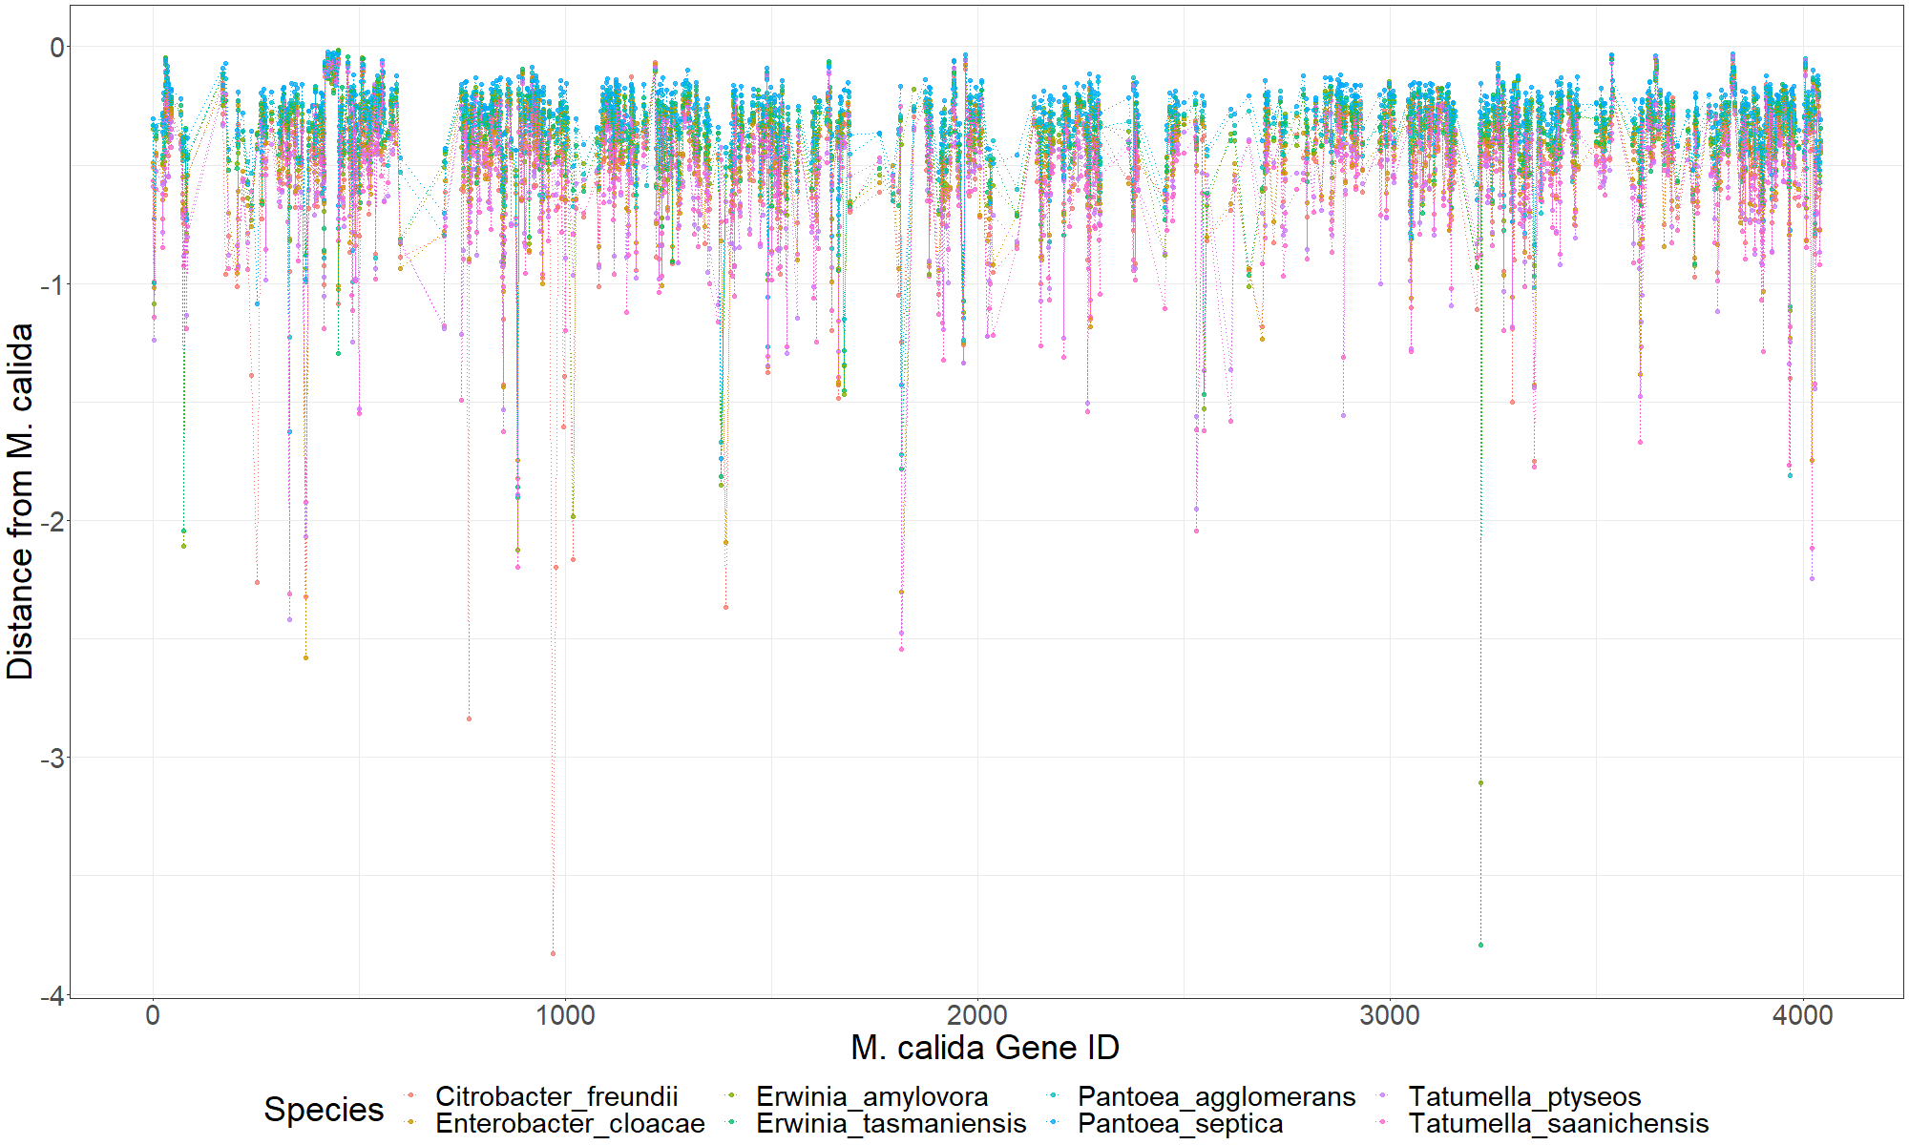
Notes:
Gene length vs distances (model)
Pull out significantly different

Slide 15
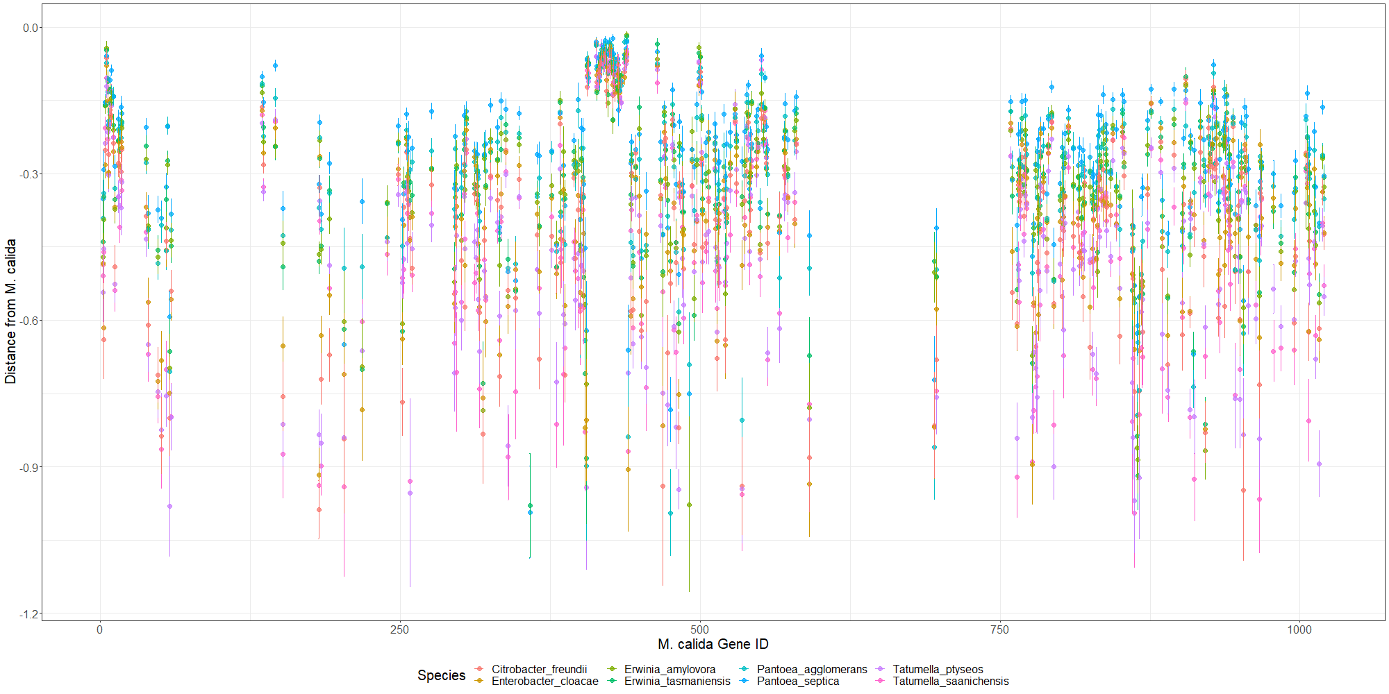
Notes:
1/4

Slide 16
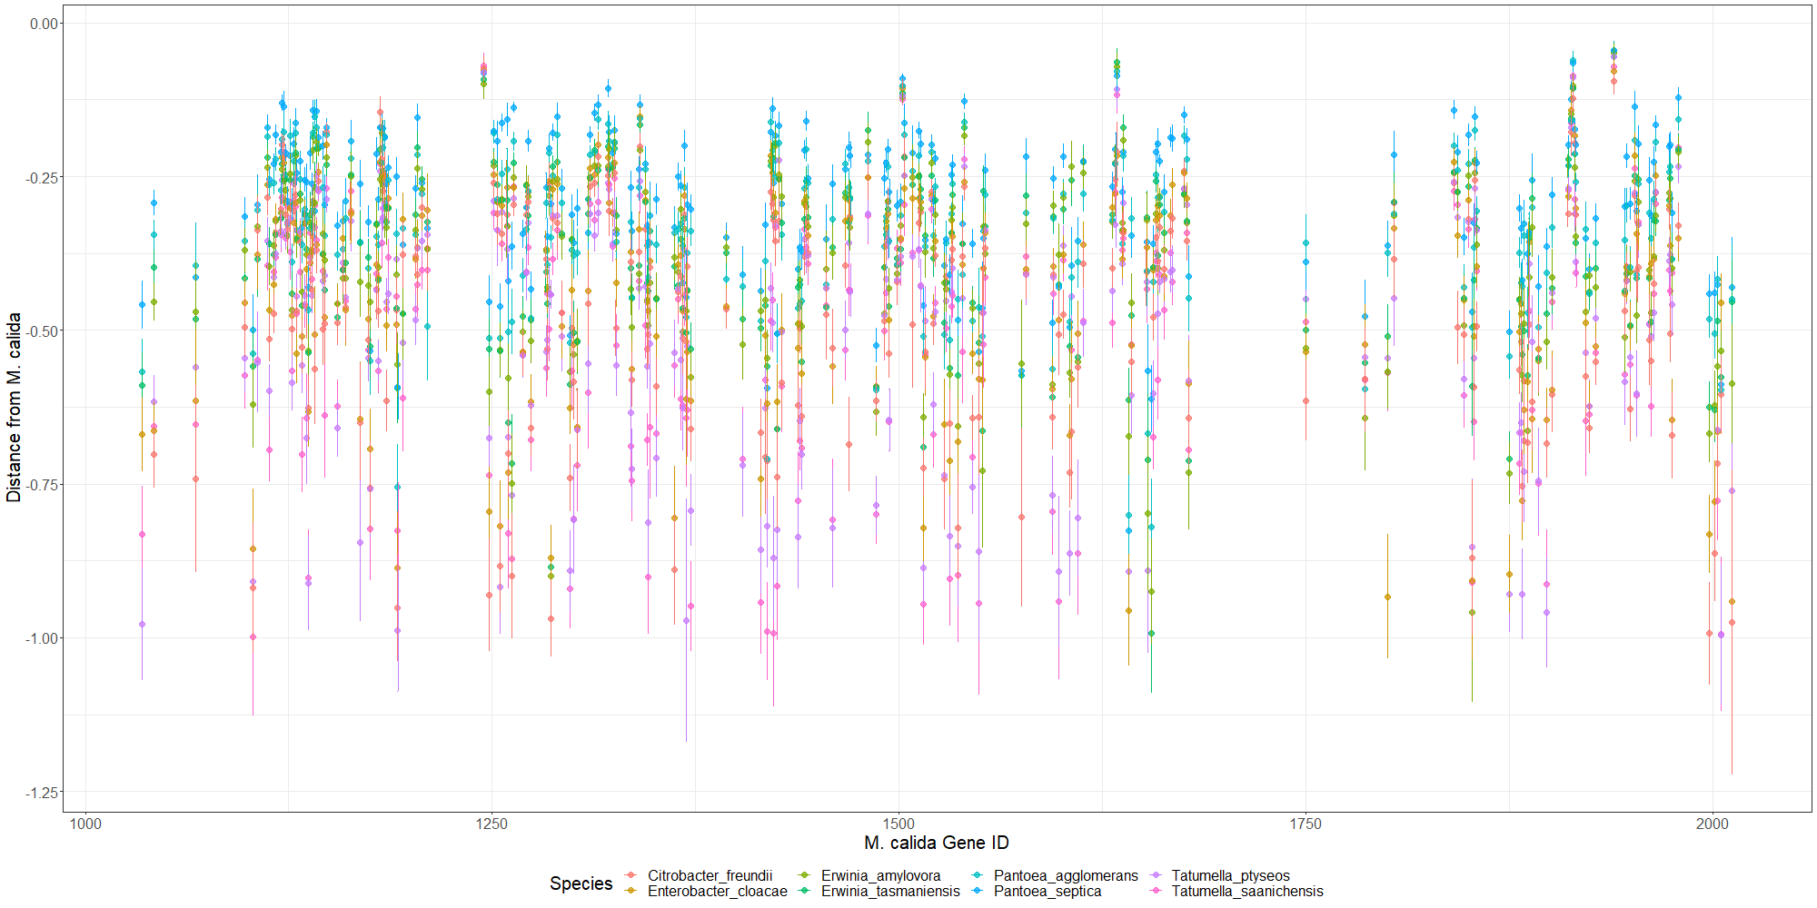
Notes:
2/4

Slide 17
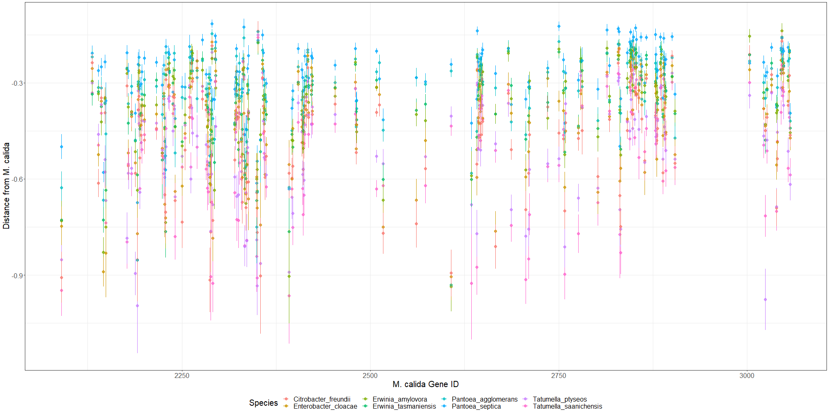
Notes:
¾
Look at order of relatives. Which ones were weird. Find the major pattern that happens most often.
Look at common MLSA genes (Palmer’s paper and Brady’s paper for Pantoea calida)

Slide 18
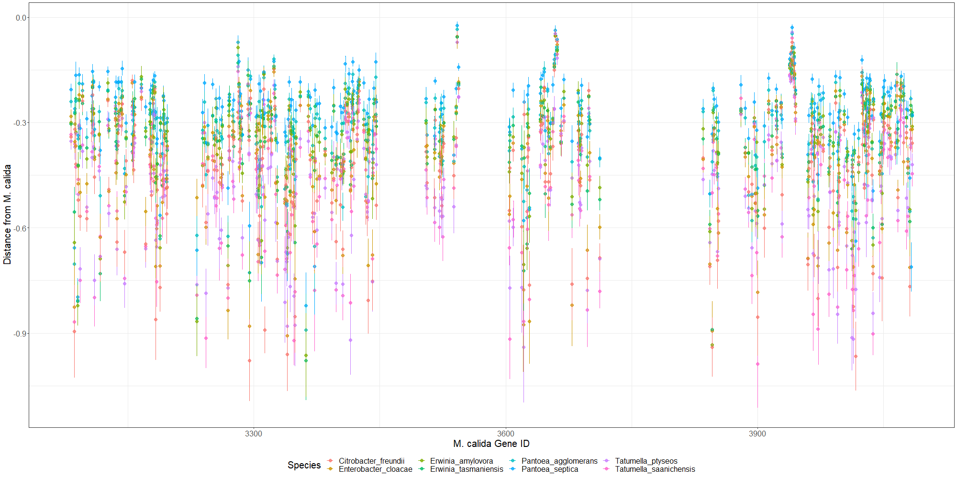

Slide 19
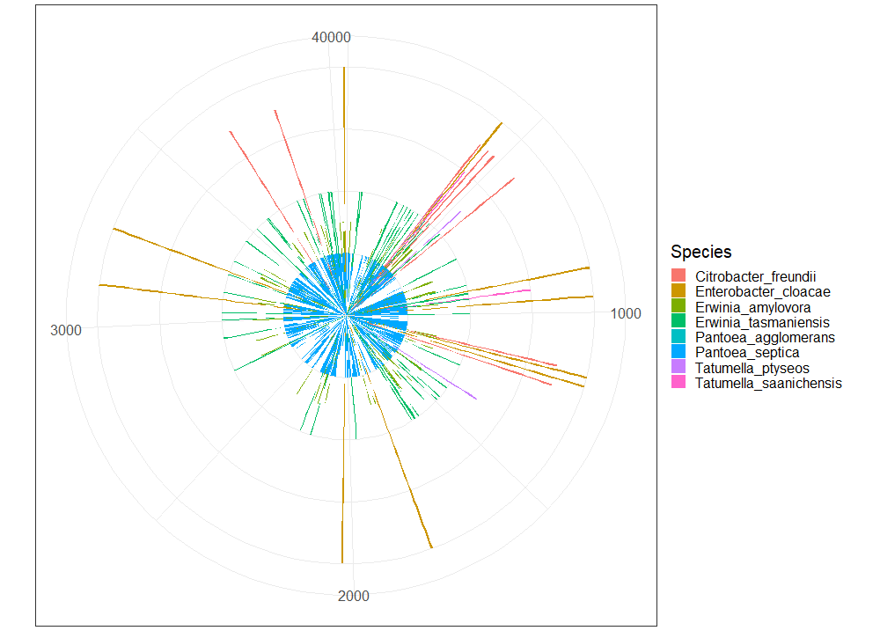
Notes:
M_calida
Trees, one for each genera. Only 5 genes
Look at the weirdos, what are they?
Gene length correlated with pattern
Of each species, how many are significant?

Slide 20
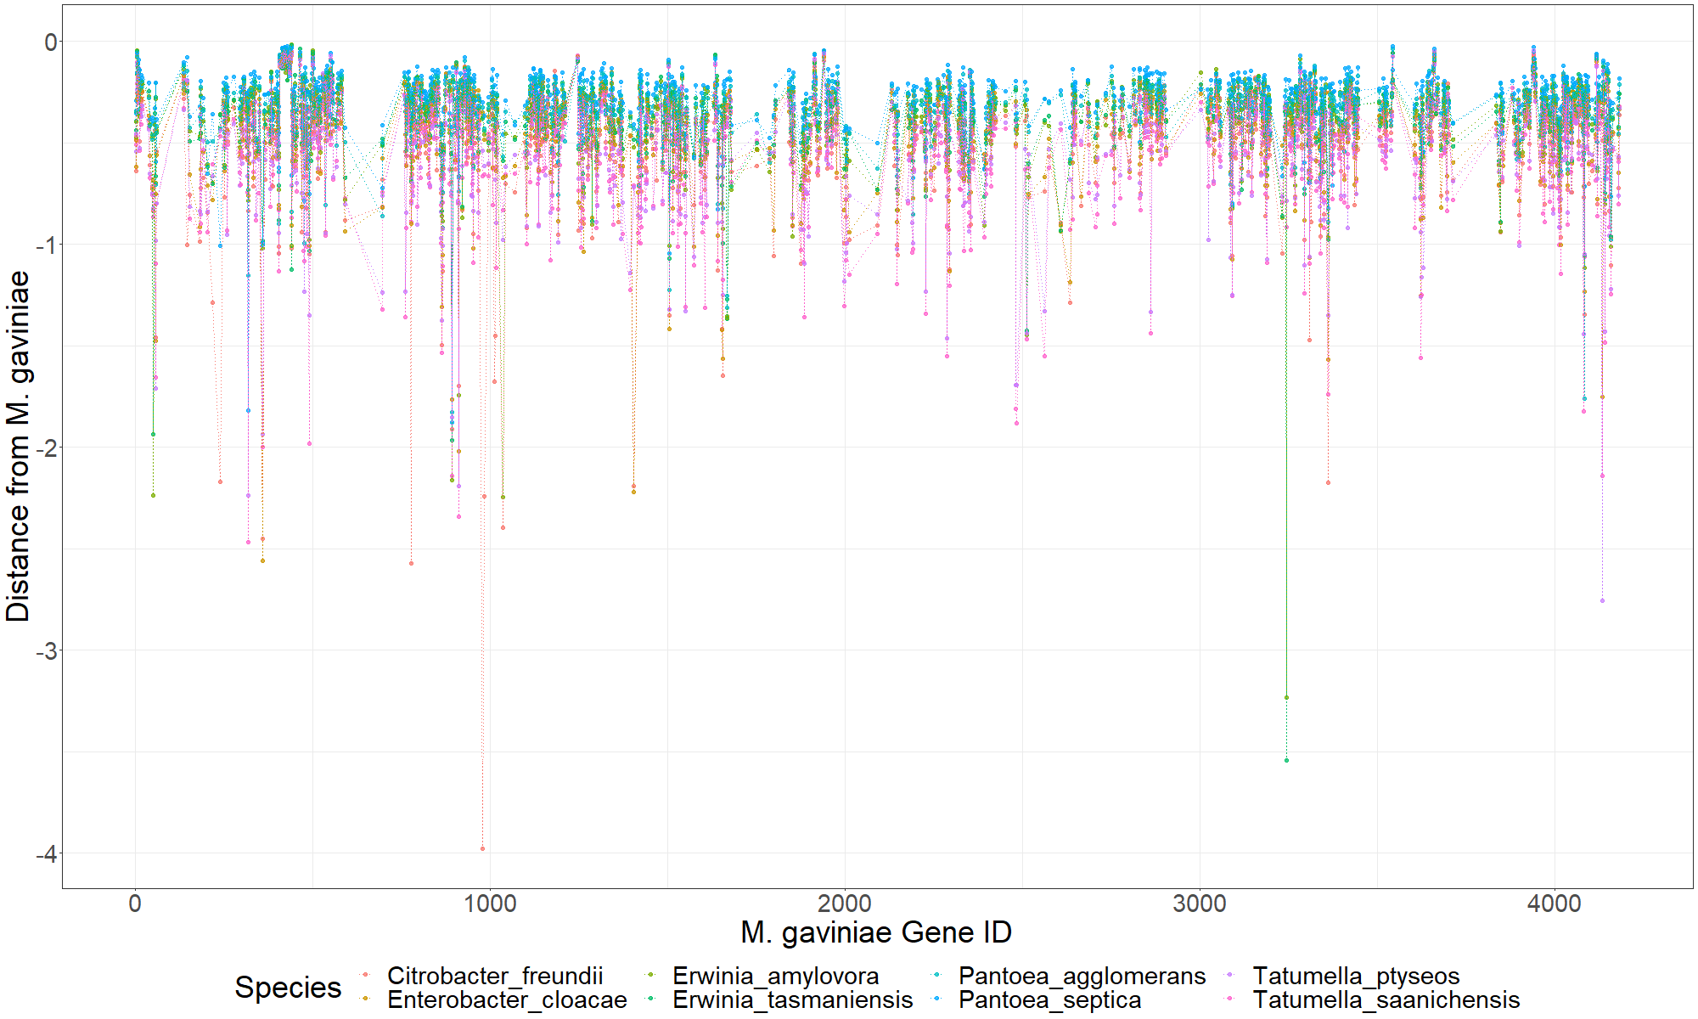

Slide 21
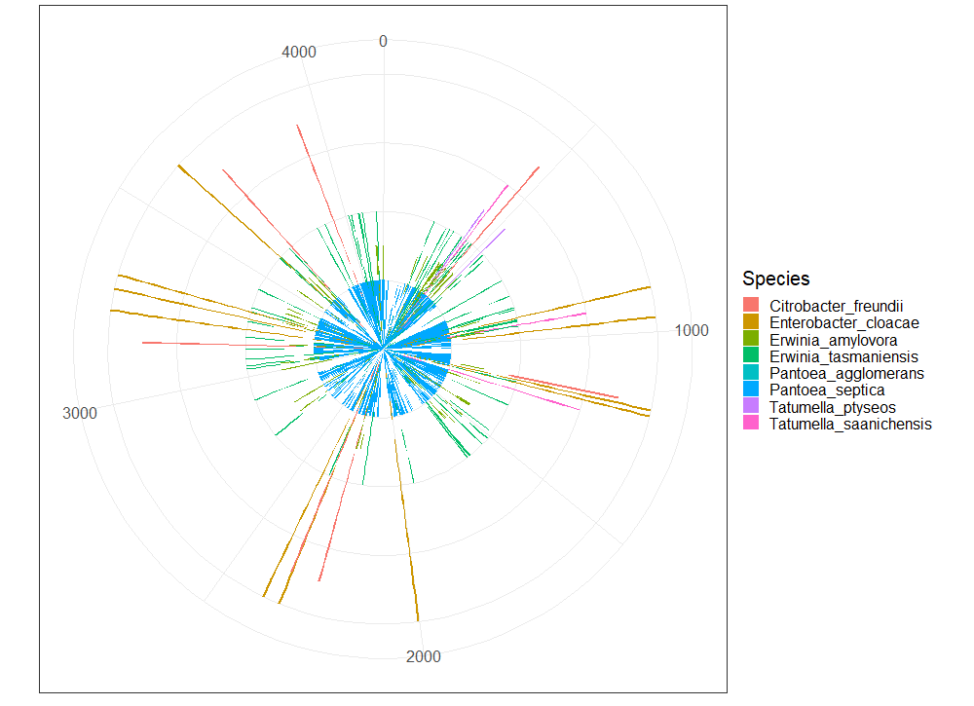
Notes:
M_gaviniae

Slide 22
Thank you

